Slide 1
RTOS-based Safety-Oriented Thermal Control System
Simulink design → STM32 FreeRTOS implementation → Embedded validation
STM32F446RE
FreeRTOS
Simulink / MATLAB
Embedded C
Model-based control design and embedded implementation of a safety-aware thermal regulation system.

Slide 2
Project Overview
* Objective
This project implements a thermal control system using a model-based design workflow.
The control algorithm was first designed and validated in Simulink, and then deployed to an STM32 microcontroller running FreeRTOS to verify real-time embedded operation.
* Key Components
Thermal plant modeling
P / PI control design
Anti-windup mechanism
Fault detection and fail-safe logic
Embedded implementation using FreeRTOS

Slide 3
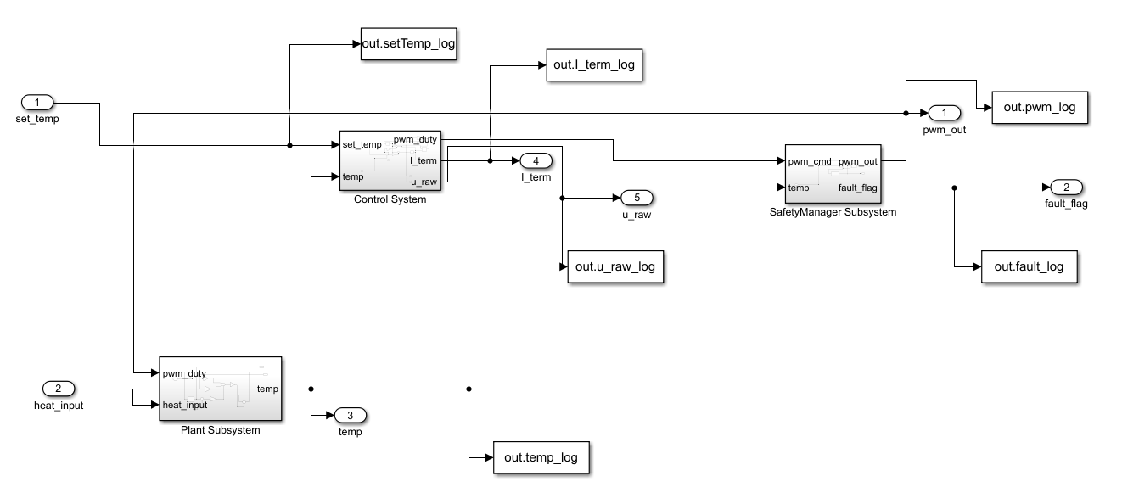
System Architecture
set_temp heat_input
│ │
▼ ▼
Controller (PI + Anti-windup)
│
▼
Safety Manager
│
▼
Plant
│
└── temp feedback
The system architecture separates the control layer, safety layer, and plant model, similar to typical automotive ECU software structures.
This separation allows safety logic to override control commands when abnormal conditions are detected.

Slide 4
Thermal Plant Model
T[k+1] = T[k] + Ts ( a·heat_input − b·pwm − c(T[k] − T_ambient) )
heat_input : disturbance heat source
pwm : cooling actuator
ambient : environment temperature
a = 3
b = 0.08
c = 0.02
Ts = 0.1 s
ambient = 25°C
The plant represents a simplified first-order thermal system including:
heat generation
cooling actuator effect
environmental heat dissipation
This model was used to simulate the thermal dynamics before deploying the controller to embedded hardware.

Slide 5
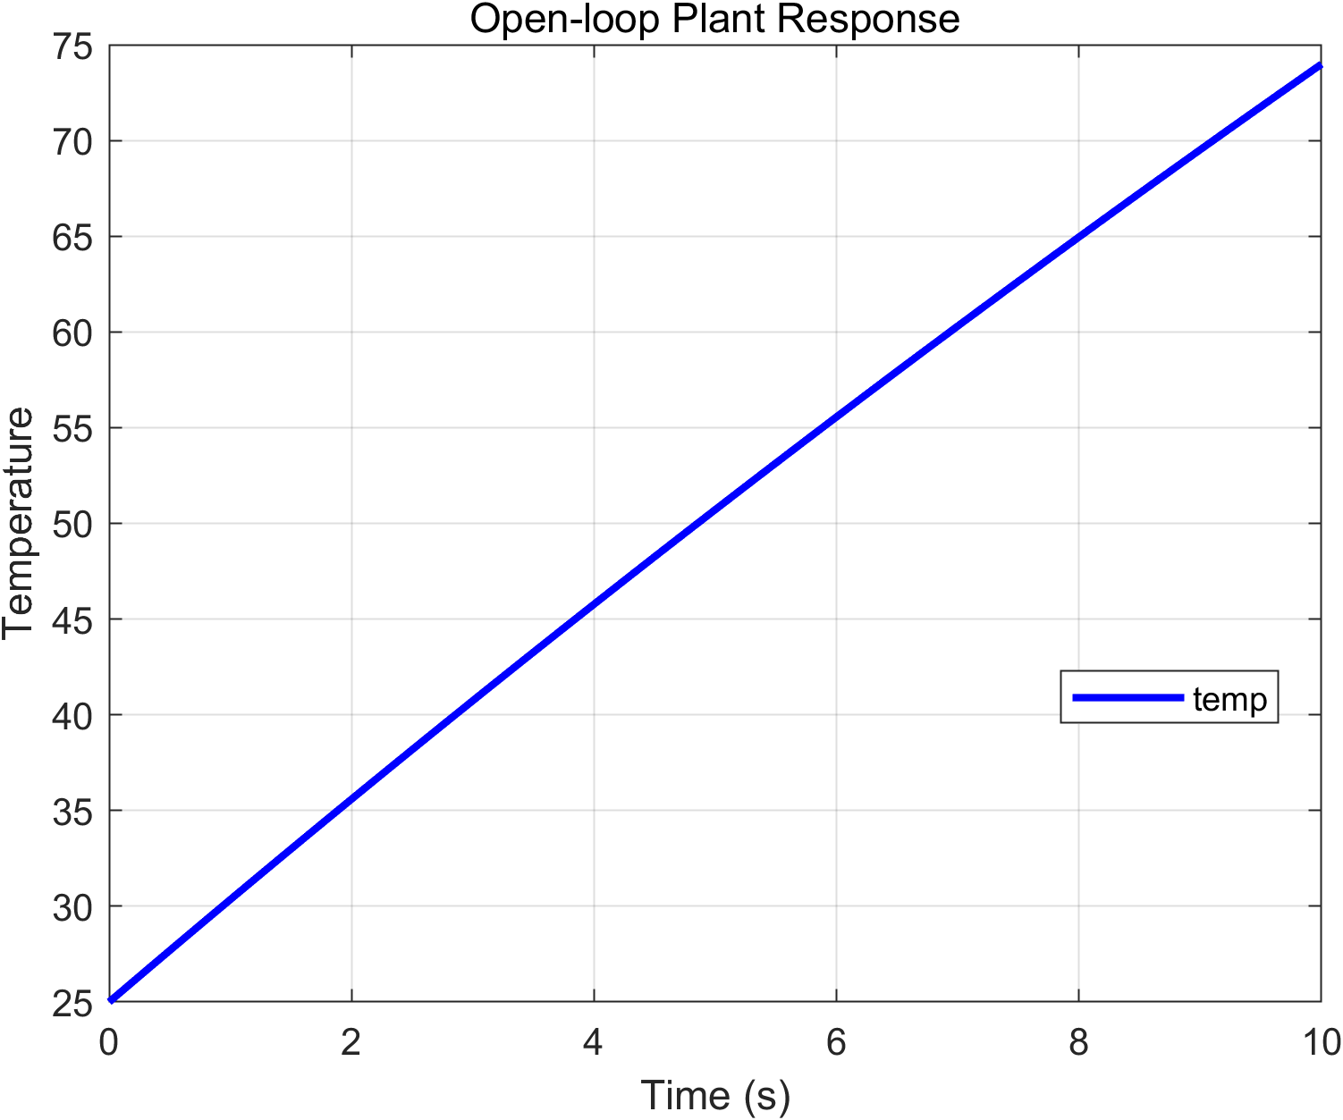
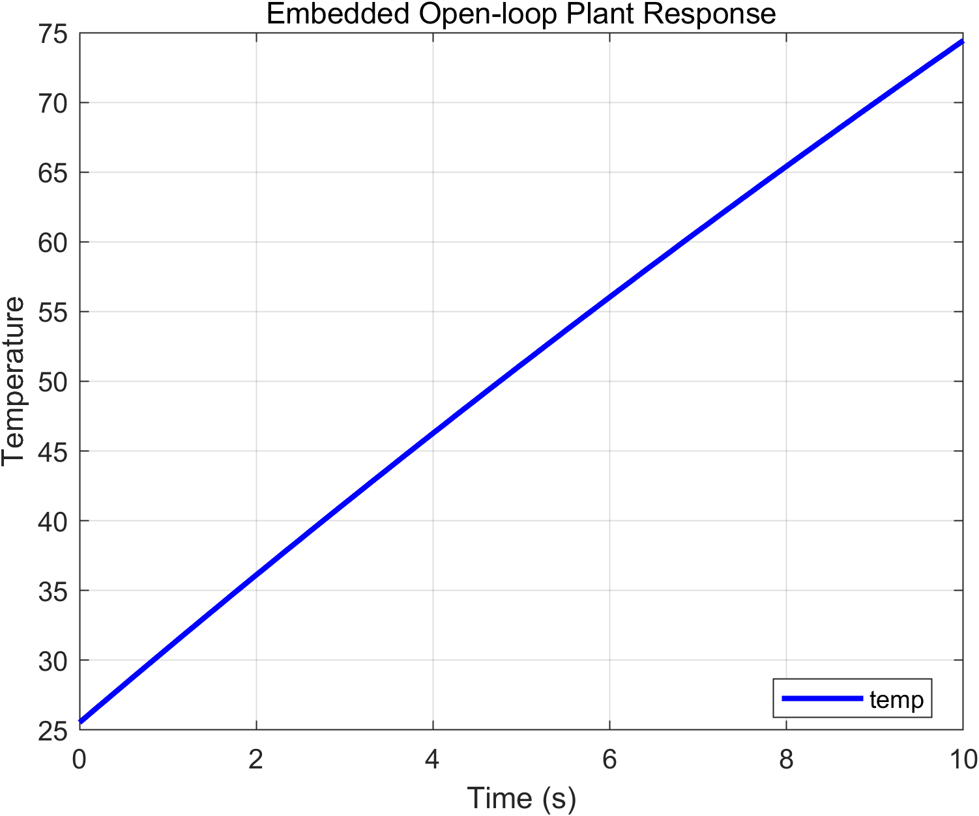
Open-loop Plant Response
Under constant thermal load, the plant temperature continuously increases due to heat input.
The system exhibits thermal inertia and slow dynamic response, which motivates the need for closed-loop temperature control.

Slide 6
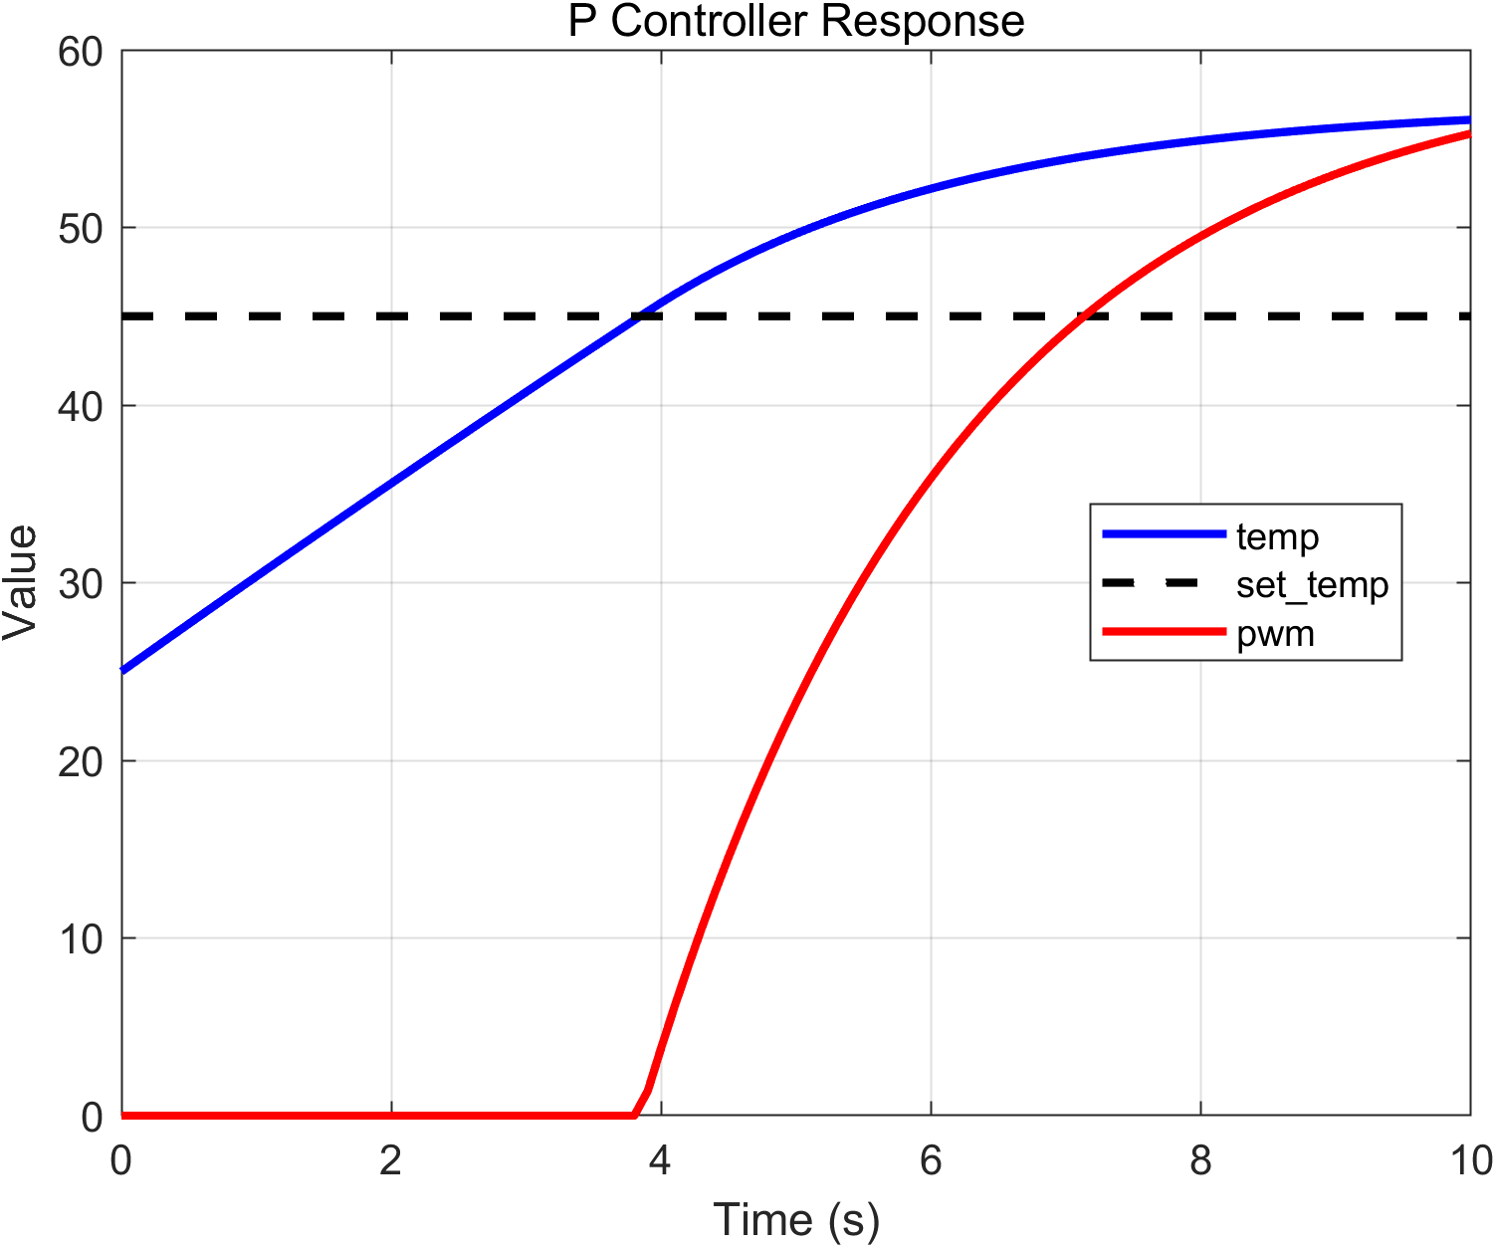
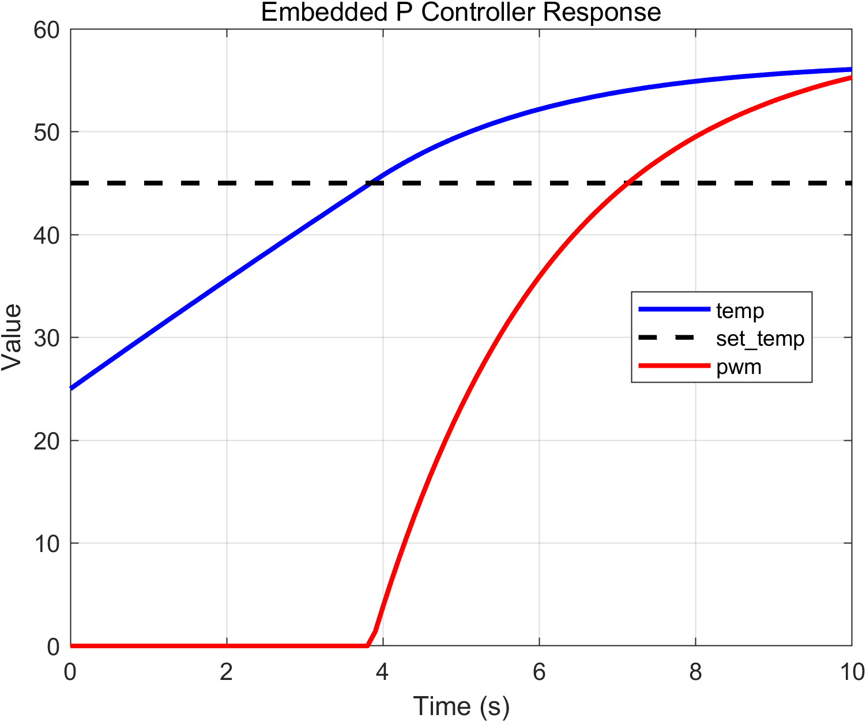
P Controller Response
Proportional control reduces the temperature error but leaves a steady-state offset.
This occurs because the controller output decreases as the error approaches zero.

Slide 7
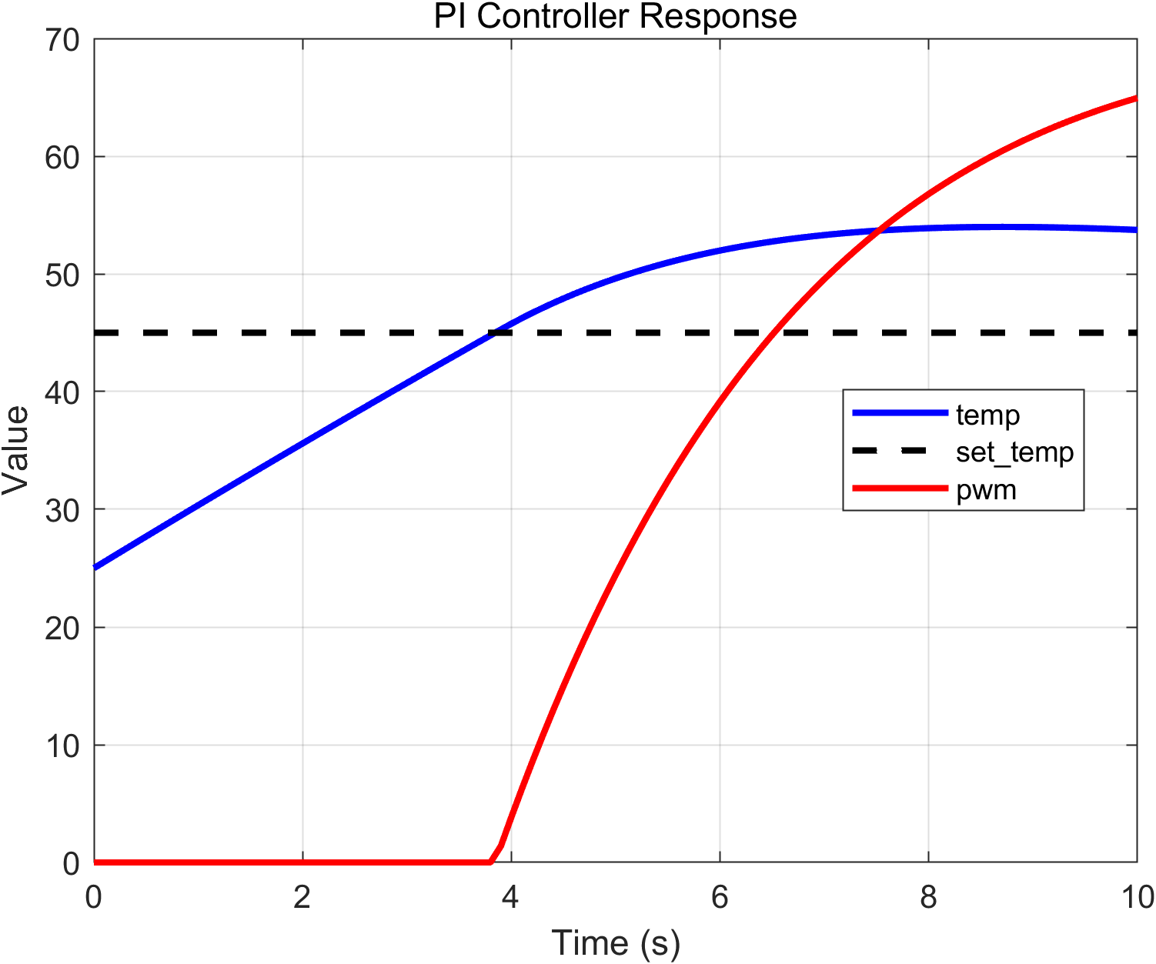
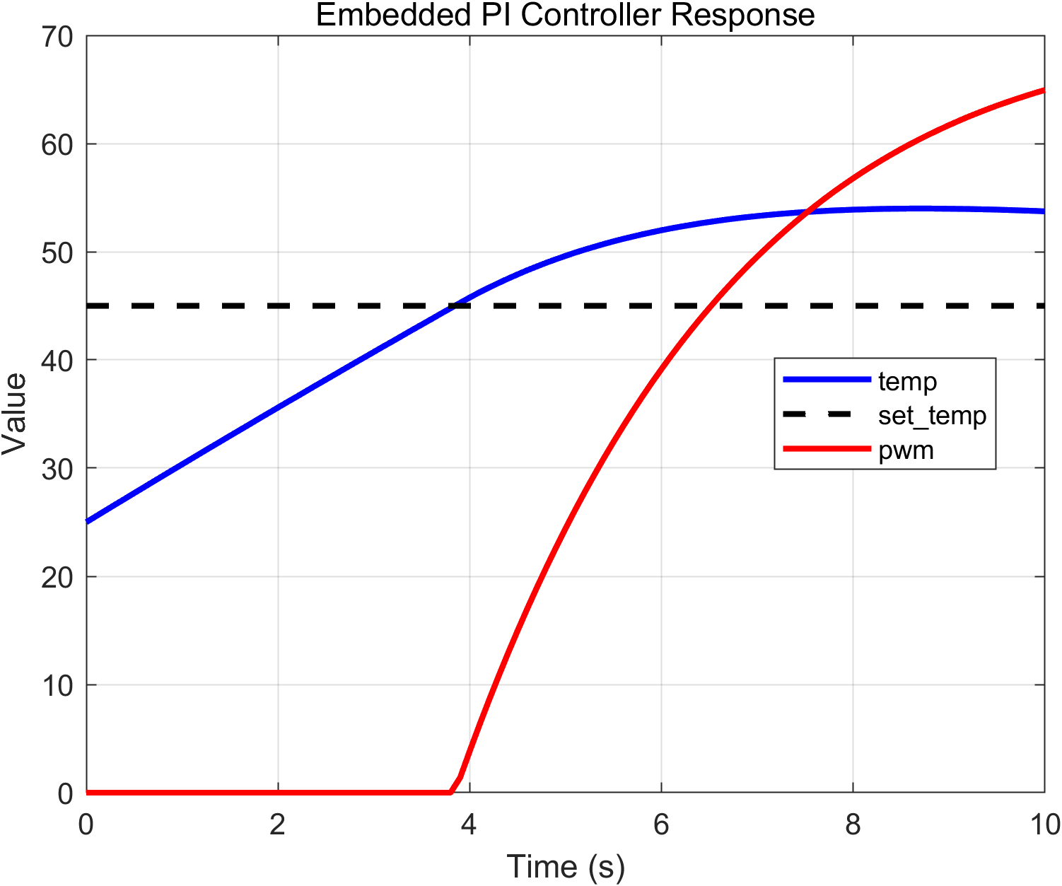
PI Controller Response
The integral term accumulates the control error over time, allowing the controller to eliminate steady-state error and accurately track the target temperature.

Slide 8
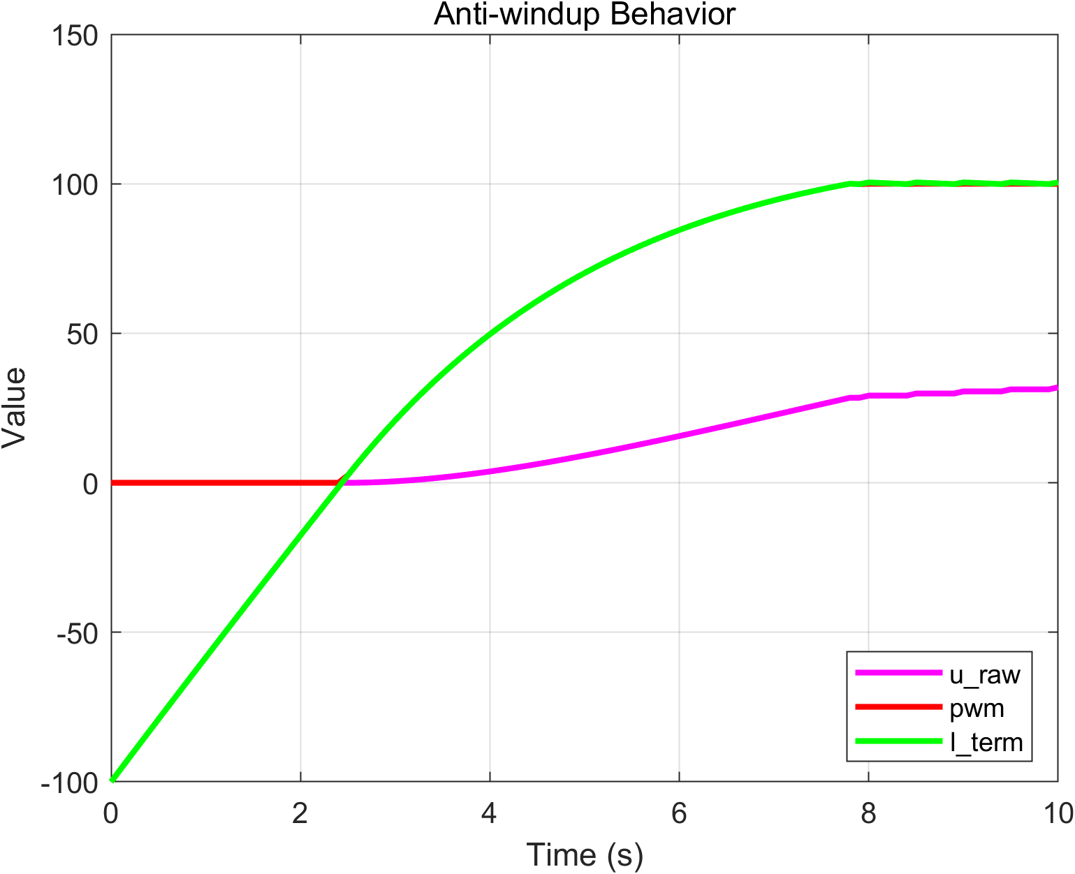
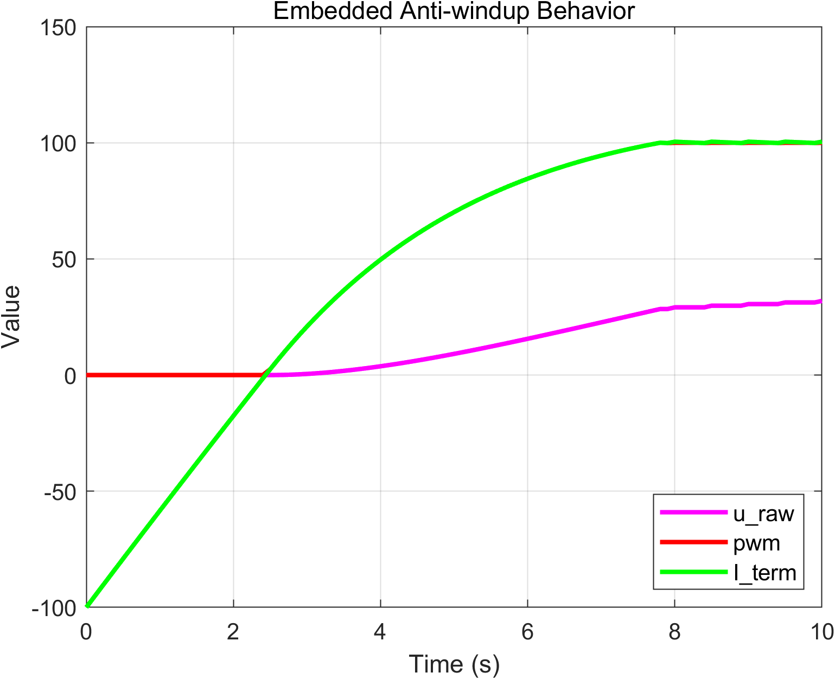
Anti-windup ON
When actuator saturation occurs, the controller output is limited.
Without anti-windup, the integral term would continue to grow, causing large overshoot once the actuator recovers.
The anti-windup mechanism prevents excessive integral accumulation.

Slide 9
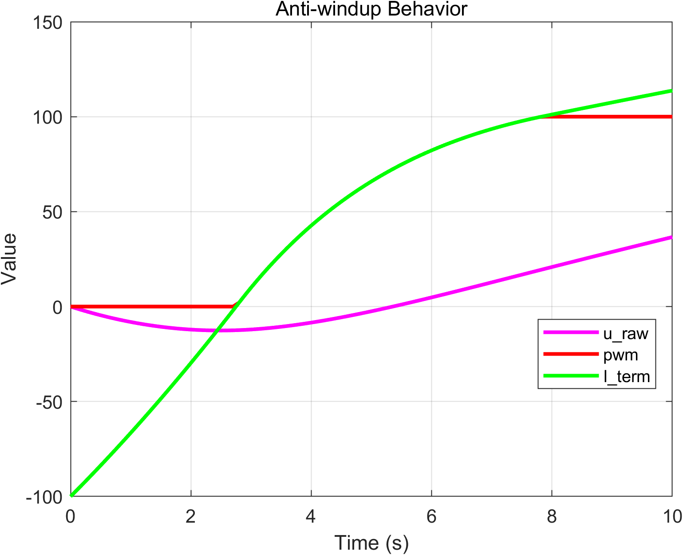
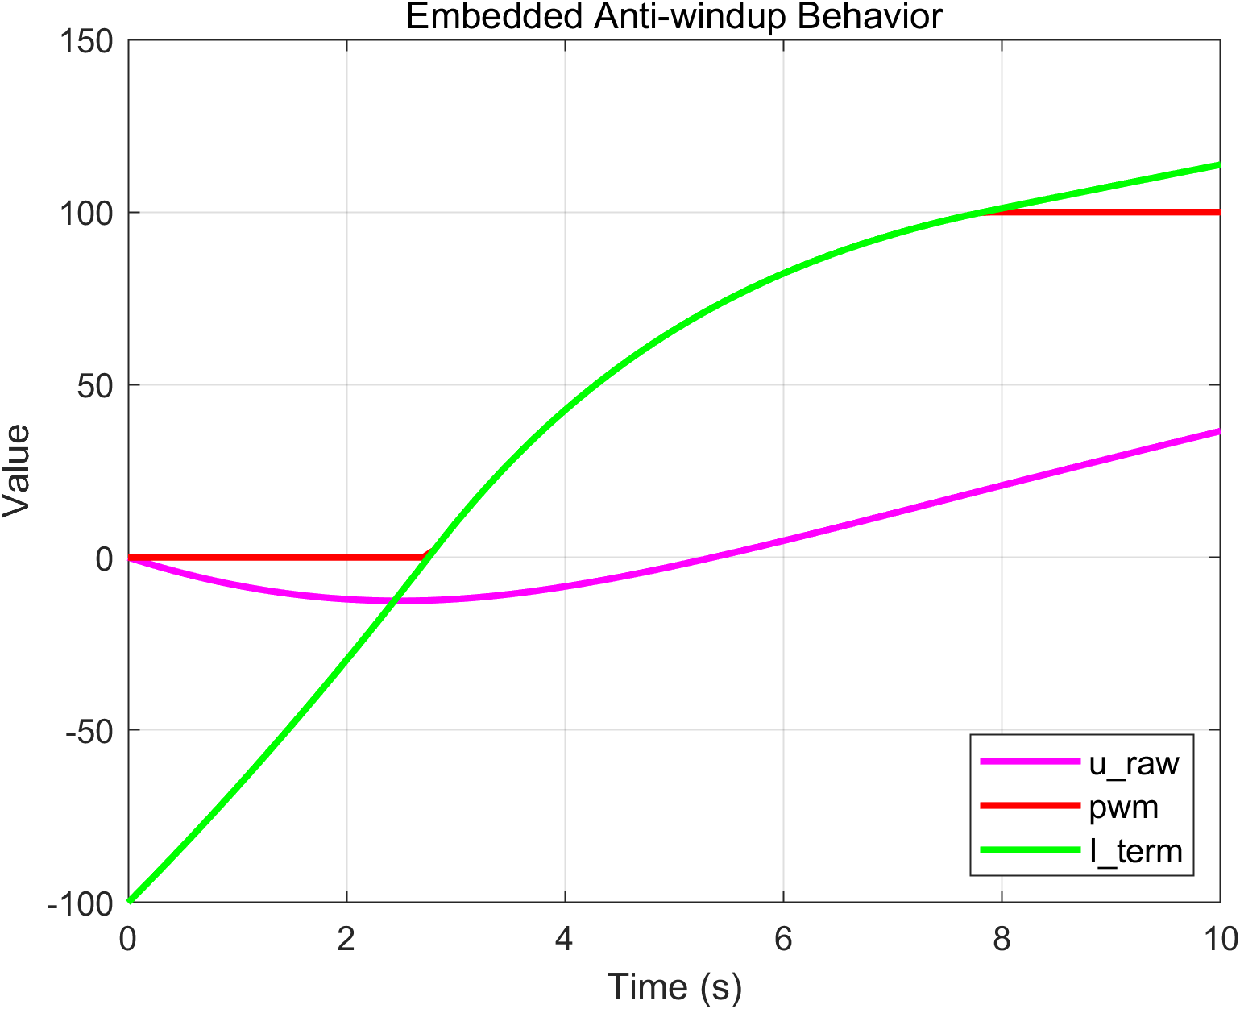
Anti-windup OFF
When actuator saturation occurs, the controller output is limited.
Without anti-windup, the integral term would continue to grow, causing large overshoot once the actuator recovers.
The anti-windup mechanism prevents excessive integral accumulation.

Slide 10
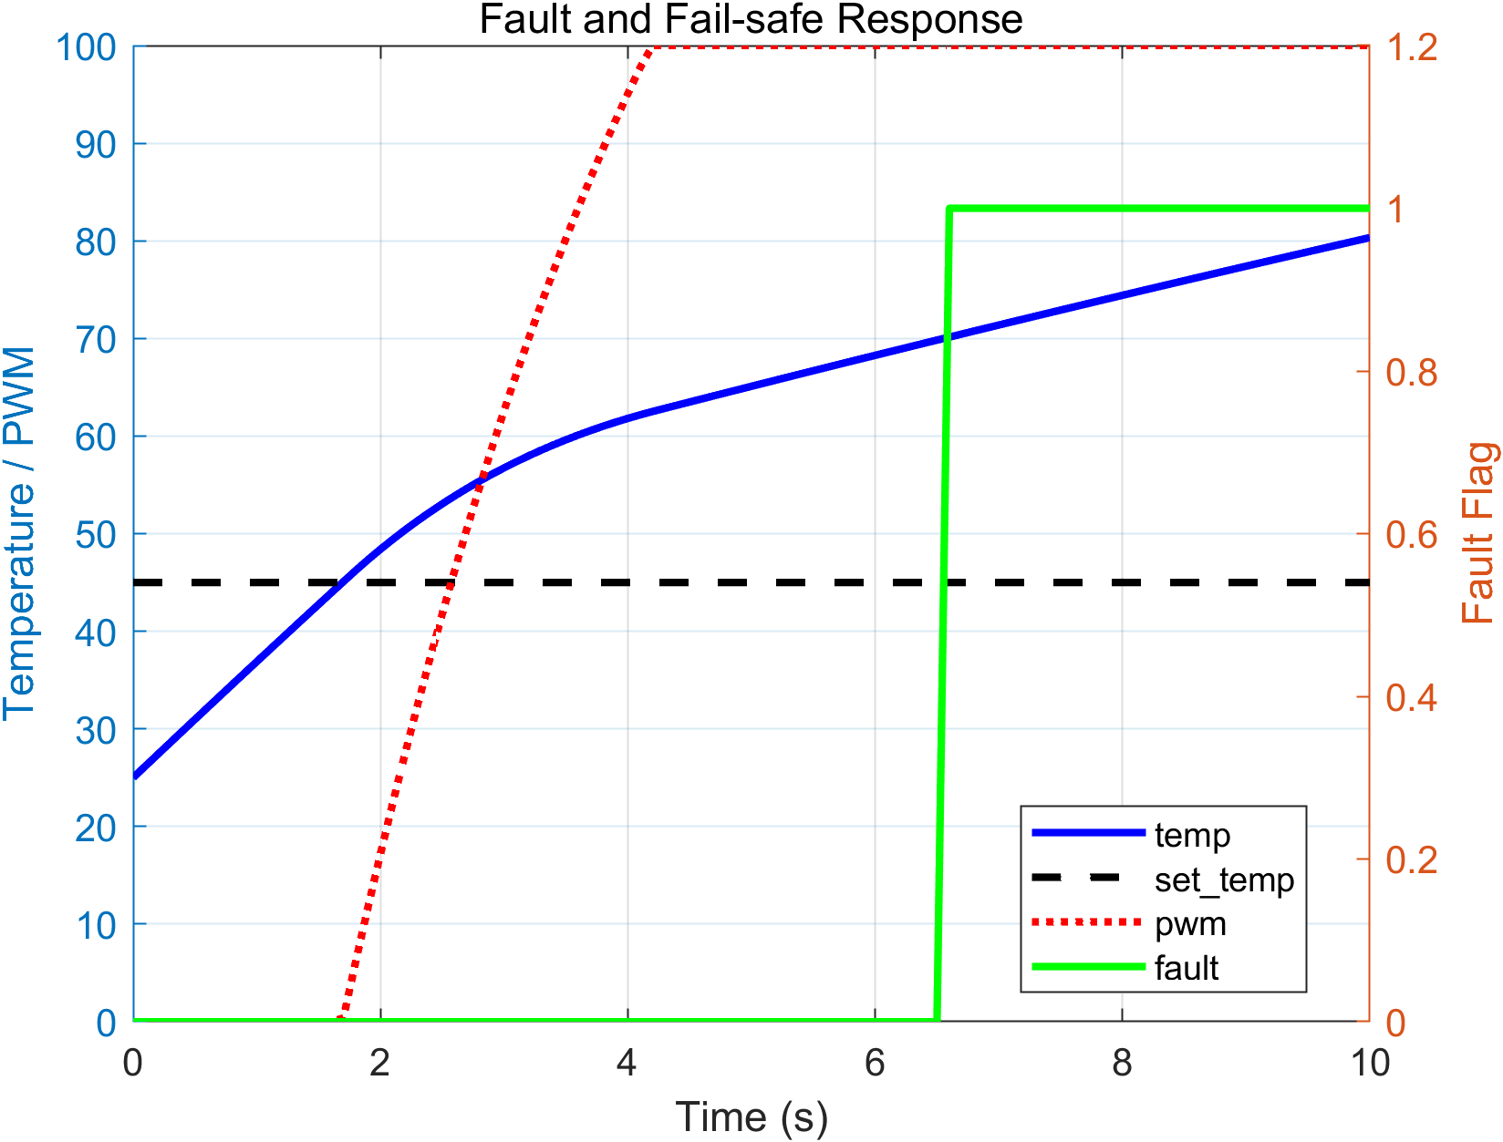
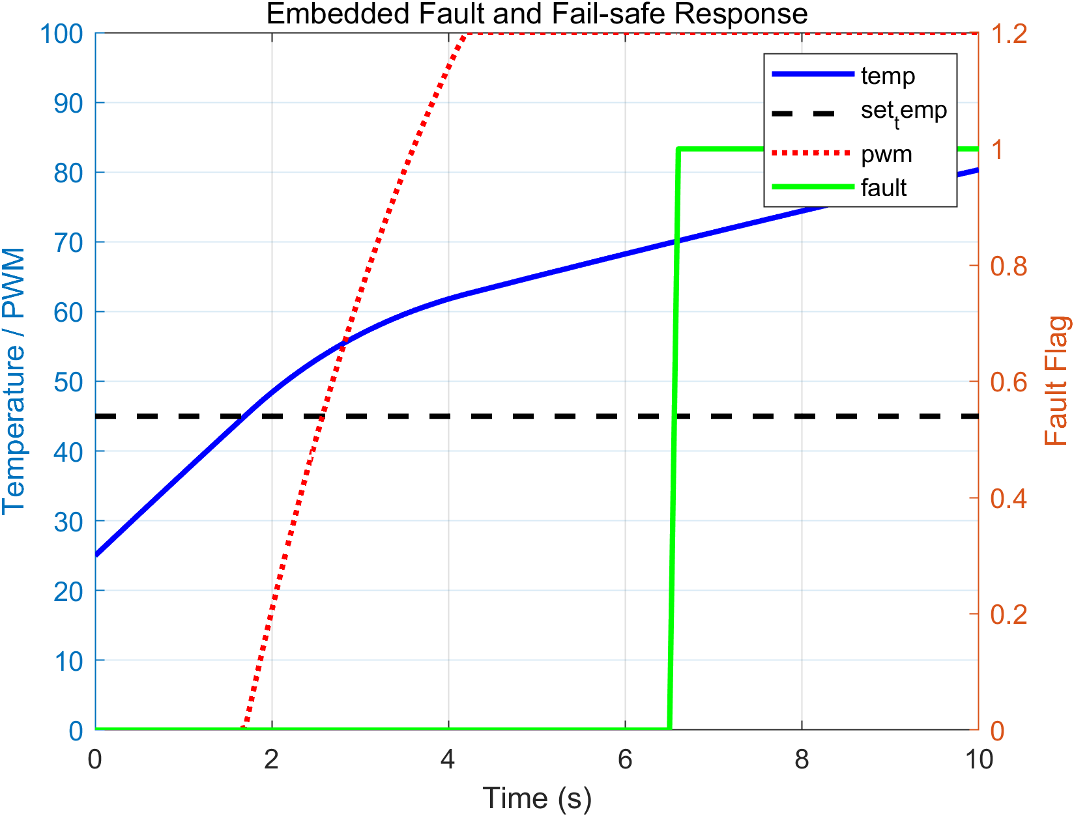
Fault / Fail-safe
If the temperature exceeds a safety threshold (70°C), the safety manager activates fault handling.
In fault mode:
fault_flag is raised
PWM is forced to maximum cooling
This mechanism ensures safe operation under abnormal thermal conditions.

Slide 11
Embedded Implementation
The control algorithm was deployed to an STM32F446RE microcontroller running FreeRTOS.
The controller executes periodically with a 100 ms control cycle.
Structure
ControlTask (100 ms) └ thermal_project_step()
Features
Real-time control execution
UART logging of temperature and control signals
MATLAB visualization for result analysis

Slide 12
RTOS Task Structure
FreeRTOS Tasks ControlTask Period : 100 ms ├ sensor reading (software plant) ├ control algorithm (PI + anti-windup) ├ safety manager └ UART logging
The RTOS scheduler ensures deterministic control execution while allowing concurrent system monitoring.

Slide 13
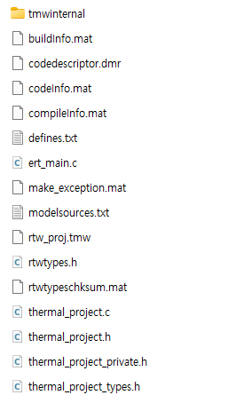
Code Generation

Slide 14
Control Loop Implementation
// Control loop execution
thermal_project_U.set_temp = set_temp;
thermal_project_U.heat_input = heat_input;
thermal_project_step();
temp = thermal_project_Y.temp;
pwm_out = thermal_project_Y.pwm_out;
fault = thermal_project_Y.fault_flag;
Simulink-generated control code executed
inside the embedded control loop.

Slide 15
PI Controller with Anti-windup
// PI control
error = set_temp - temp;
u_raw = Kp * error + I_term;
// Anti-windup
if ((!(u_raw > 100.0)) && (!(u_raw < 0.0)))
{
I_term += KiTs * error;
}
Anti-windup prevents integrator accumulation
when actuator saturation occurs.

Slide 16
Troubleshooting (Using Simulink)
Issue
During anti-windup OFF verification, the simulation result was initially inconsistent with the expected integrator growth behavior.
Cause
The input signal connected to the integrator block was incorrectly configured in the Simulink model.
Fix
The integrator input path was corrected, and the simulation was repeated.
Result
After correction, the anti-windup OFF case showed the expected integrator accumulation and overshoot behavior.

Slide 17
Conclusion
This project demonstrates an end-to-end workflow for embedded control development:
Thermal control system modeling
Control algorithm design in Simulink
Embedded deployment using STM32 and FreeRTOS
Validation through simulation and hardware execution
The results confirm that model-based design can effectively bridge simulation and real-time embedded implementation.

